Slide 1


Data Science with {Python}:
An Introductory Class
Anish Mahapatra | 08 December, 2022

Slide 2

Agenda
01
Introduction
02
What is Data Science?
03
Why Data Science?
04
Real-world Applications of Data Science
05
Tools & Technologies, Job strategies and CTC
06
Let’s Talk!

Slide 3












Topic 1 of 6
Introduction: Am I worth your time?
Senior Data Scientist
LinkedIn: www.linkedin.com/in/anishmahapatra Medium: anishmahapatra.medium.com Website: www.anishmahapatra.com
GitHub: www.github.com/anishmahapatra
Q. How to get into Data Science?
A. Simple, ask a real-world Data Scientist.

Slide 4
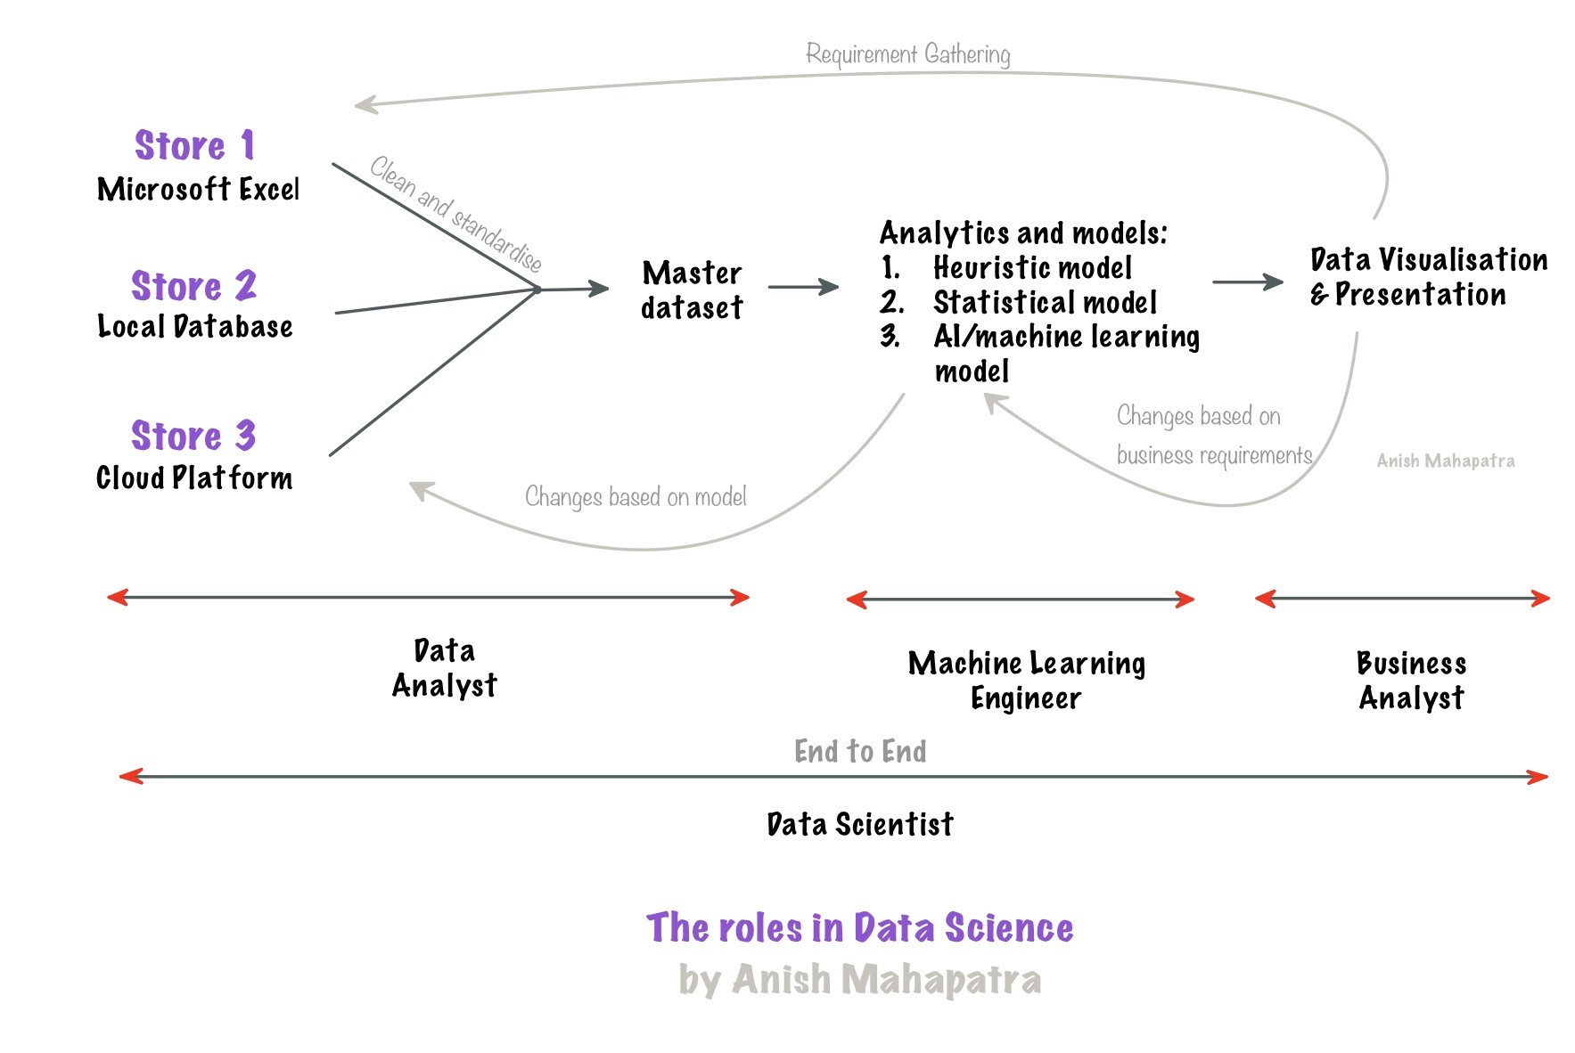
Topic 2 of 6
What is Data Science?

Slide 5
Topic 2 of 6
What is Data Science?
01
02
03
Data Access
Data Silos to Data Warehouse
Data Analytics & Modelling
Identify List of Data Owners,
Request Access,
Maintain Single POC,
Understand current process
Exploratory Data Analysis,
Business Analytics,
Heuristic, Statistical & ML Models.
Experimentation
Make Data Dictionary,
Set up Data pipelines, Make ER Diagram, Main Analytical Data frame
06
05
04
Business Decisions, Impact Analysis
Data Visualization & Dashboarding
Feature Engineering
Building new features, Combining external data, Building a feature store
Model Evaluation, Monitoring Model Performance and Drift, Data Governance Policies
Dashboards to aid decision-making,
Decide concurrency, cadence and security

Slide 6




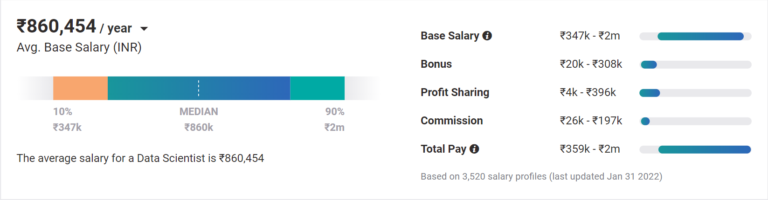
Topic 4 of 6
Why choose Data Science?
01
02
03
Relevance in the future
Business & Technology
Industry-Agnostic
Companies are building and growing in Data and it is the future.
Data Science is a combination of Business, Math and Technology, so growth can be in business / technology
Use your existing knowledge / domain / technology expertise with a data-edge
04
Extremely High Market Demand
Supply-Demand mismatch means companies are willing to pay more
Notes:
Source:https://www.payscale.com/research/IN/Job=Data_Scientist/Salary

Slide 7


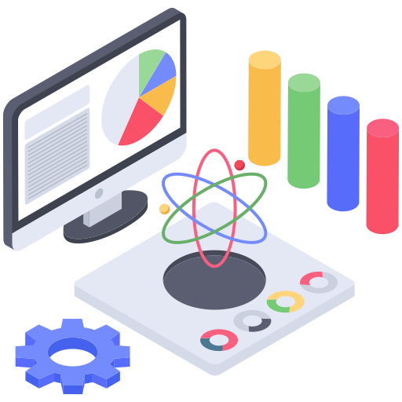
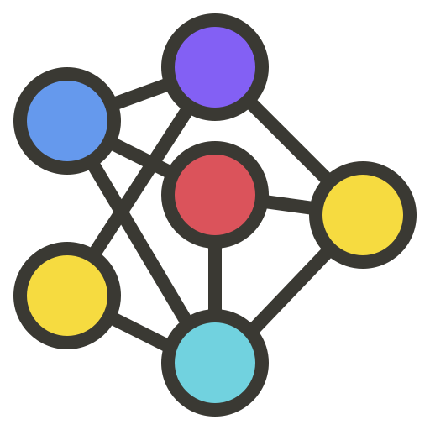

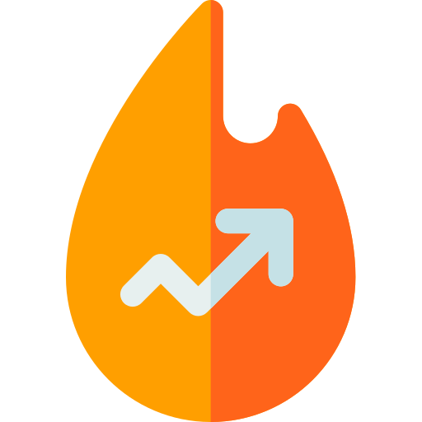

Topic 4 of 6
Real World Applications of Data Science
Customer Behaviour Analytics
Artificial Intelligence
Social Media Analytics
Computer Vision
Leveraging Patterns & Trends
Cloud Computing & Cyber Security

Slide 8

Topic 4 of 6
How to leverage a degree to get there?
01
02
03
Set Target
Talk to people
Build LinkedIn Profile
Understand the Data Field,
Understand roles & responsibilities,
Look at a 5-year path
Talk to people who are already doing what you want to do
Add certifications, participate in competitions, do simple projects, look at how the best of the best do it
06
05
04
Build Collaterals & Profile (30%)
Data Science & Analytics
Certification (70%)
Explore Certifications
Multiple certifications don’t help, the quality of it does.
GitHub, LinkedIn,
Medium, Brand Profiling
The Best Mentors,
Data Science from Start to Finish,
Multiple Projects and use-cases,
Leaning how to crack interviews,
Live Session and Help from the Experts,
Learning Python, SQL
Internship Plus, Placement Plus
Notes:
All we care about is how to get a job, let me tell you how to leverage MSc to get a job!

Slide 9







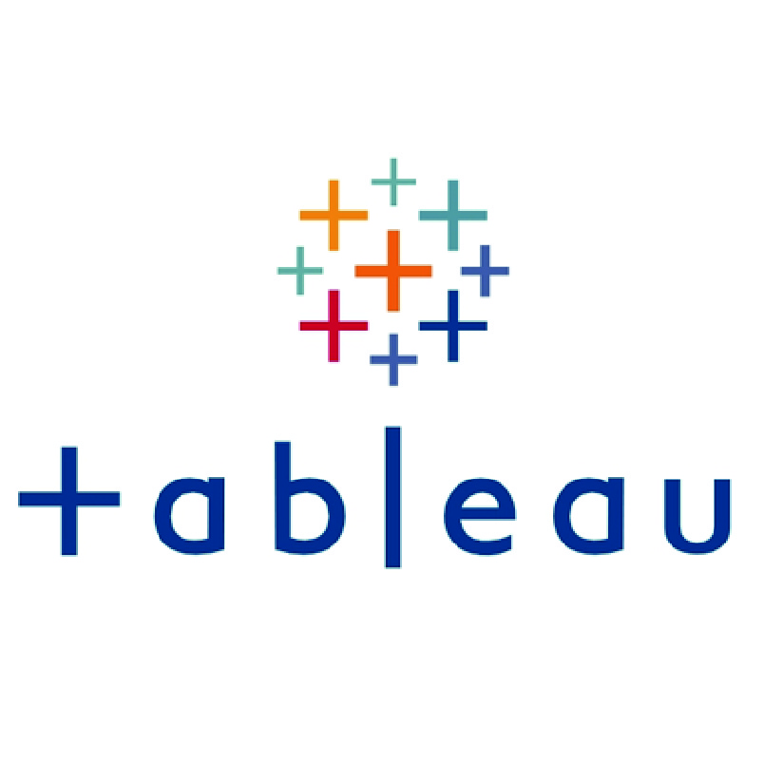
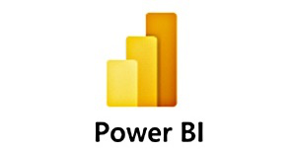
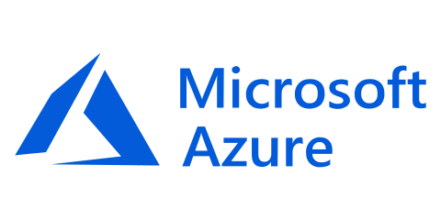


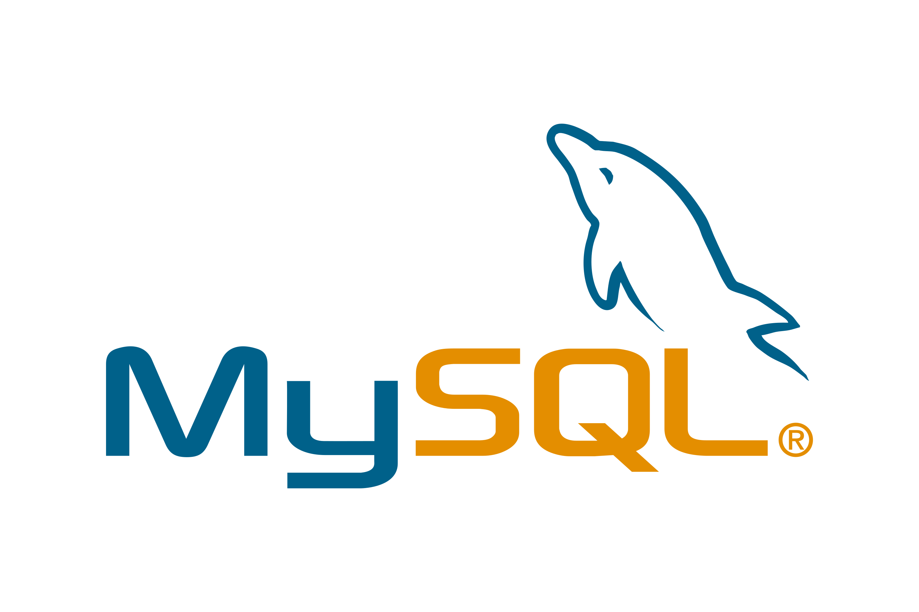
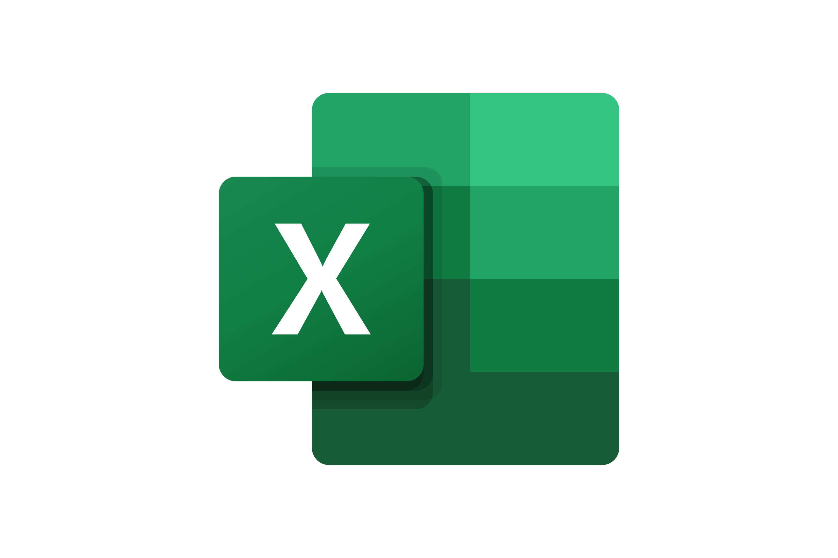
Topic 5 of 6
Tools & Technologies in Data Science
Data Engineer / Data Analyst
Machine Learning Engineer
Business Analyst
Data Scientist

Slide 10









Topic 5 of 6
Resume Optimization

Slide 11
Key Takeaways
01
Introduction
02
What is Data Science?
03
Why Data Science?
04
Real-world Applications of Data Science
05
Tools & Technologies, Job strategies and CTC
06
Let’s Talk!

Slide 12

Data Science with {Python}:
An Introductory Class
Anish Mahapatra
Let’s Talk!
https://bit.ly/PythonWithAnish
LinkedIn: www.linkedin.com/in/anishmahapatra
Email: anishmahapatra01@gmail.com
Notes:
https://bit.ly/PythonWithAnish

